Slide 1


Slide 2

Oracle E-Business Suite Applications Technology: Diagnostics and Troubleshooting
Biju Mohan, Principal Product Manager; Carlo Beekman, Principal Technical Support Engineer; Gustavo Jimenez, Applications Development Manager

Slide 3
The following is intended to outline our general product direction. It is intended for information purposes only, and may not be incorporated into any contract. It is not a commitment to deliver any material, code, or functionality, and should not be relied upon in making purchasing decisions. The development, release, and timing of any features or functionality described for Oracle’s products remains at the sole discretion of Oracle.

Slide 4


Agenda
<Insert Picture Here>
e-Business Suite Architecture: Intro
Diagnosing and troubleshooting challenges
Value of understanding
Troubleshooting topics
Oracle Application Framework based applications
Java Object Cache
Forms based applications
Middle Tier Performance
Appendix
Useful information

Slide 5

Architecture

Slide 6
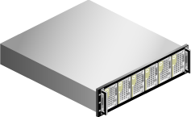




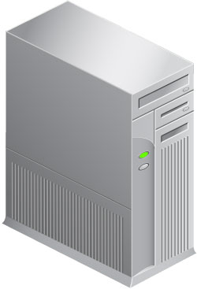


Introduction to e-Business Suite Architecture Basic 3-tier architecture
Database Tier | Application Tier | Client Tier
Clients
Hardware load balancer
Application
Servers
Concurrent processing server (optional)
Database

Slide 7
Diagnosing and troubleshooting challenges A very complex system
Complex system with complex components
Highly customizable product
High number of configuration permutations
Configuration errors have a very important cascading effect
Some legacy code
Code constantly evolving
Performance versus system load
Deltas between environments
Endless list of considerations

Slide 8
Value of understanding Getting the most out of Support and Development
Faster problem resolution
Minimum interaction = Best interaction
Ensures all instance-specific variables and deltas are ruled out.
Key: understanding technology components.
Differentiate between forms based applications and OAF based applications
Diagnose directly on the layer where the problem occurs
Communication protocols (HTTP, SQL*Net, Forms over HTTP)

Slide 9
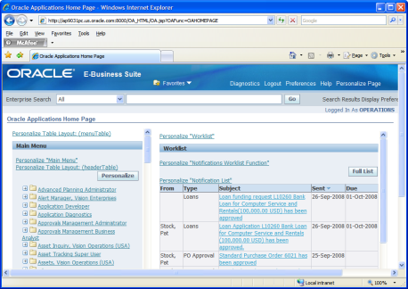
Oracle Applications Framework What is it?
A Model-View-Controller development tool used to build E-Business Suite artifacts
OAF-UIX → View layer
BC4J → Database/Model layer
OAController → Event Handler (Java)
Key to identify
Layer where the error occurs
All relevant messages
OAController
BC4J
OAF/UIX

Slide 10
Oracle Java Object Cache (JOC) Summary
Cache engine designed to prevent round trips to the database from the middle tiers or java applications
Additional layer for E-Business Suite (JTF Cache)
Handles cached entities, time to live and invalidation events
Integrates with non-java applications via Business Event System for invalidation events via PL/SQL layer and event propagation.
Caches entities with low entropy (Profile options, lookups)
High entropy data not recommended for caching

Slide 11
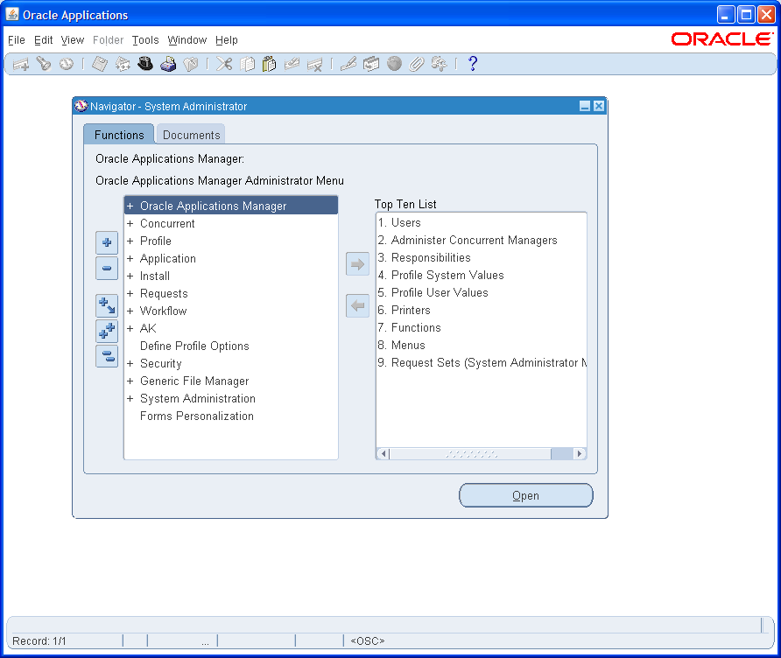
Oracle Forms
Definition
A tool to build forms based on database tables
Logic built on the PL/SQL engine
Runs on a java virtual machine in the client as an applet
Communicates with the server via forms protocol over HTTP or sockets (deprecated)
Legacy platform

Slide 12


Troubleshooting Oracle Applications Framework based applications

Slide 13
Troubleshooting OAF based applications What to do when the application errors out?
Scenario #1: Your transaction fails with an error
Debug the page that is failing
The “FND Diagnostics” profile option
Enables additional troubleshooting options
SQL Traces
On screen logging
“About this page” link
When to use:
When the page is functional despite the error

Slide 14
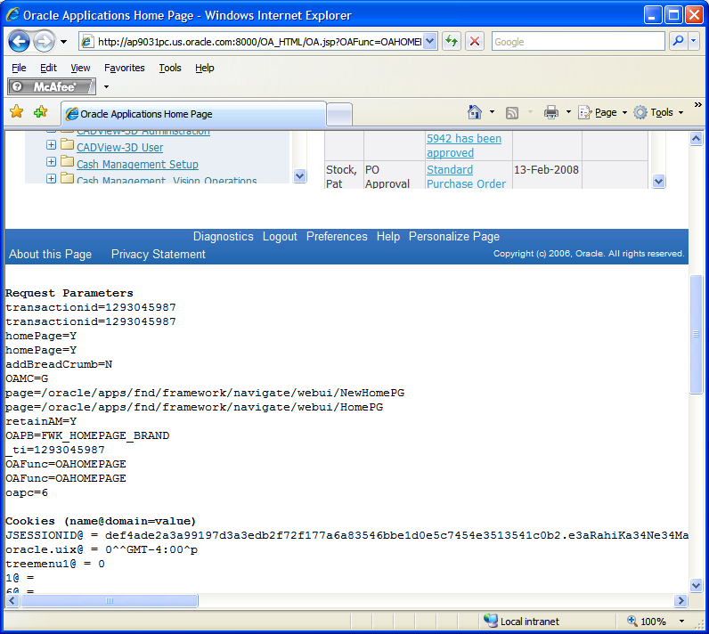
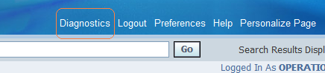
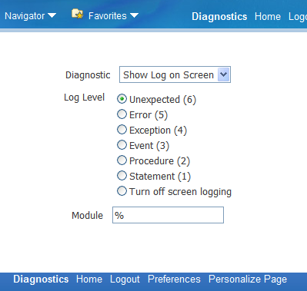
Troubleshooting OAF based applications Scenario #1, continued
Requires “FND: Diagnostics” set to “Yes”

Slide 15
Troubleshooting OAF based applications What information do I get?
Request parameters
Cookies
Session data
Debug log
BC4J Logging (queries)
Whenever possible, save this data into a file and upload it through My Oracle Support

Slide 16
Troubleshooting OAF based applications Another example
Scenario #2: The page fails to render
Verify HTTP traffic between client/server (Fiddler2). Pay special attention to cookies
Use Applications Logging (AFLOG)
Use a file (AFLOG_FILENAME) if DB connectivity fails
Enable JBO logging as well to capture SQL traffic
Check database’s alert.log (MAXEXTENTS in ICX_SESSIONS/ICX_TRANSACTIONS)

Slide 17
Troubleshooting OAF based applications Continued
Self-explanatory messages
Do ask us for help whenever necessary
Custom code:
Reproduces after disabling custom code?
Not supported.
Play with Jdeveloper → Reproduces?

Slide 18
Troubleshooting OAF based applications Troubleshooting tools
“About this page” link (Required diagnostics turned on)
Shows page structure
Shows involved BC4J objects
Useful for customizations/extensions
Shows context for diagnostics purposes
Personalizations, In memory profile options, Patches, Java system properties, etc

Slide 19
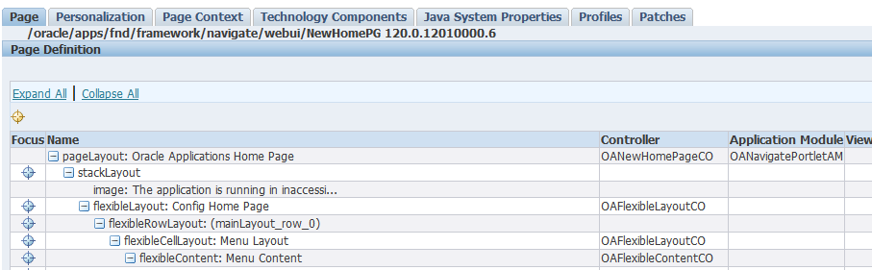
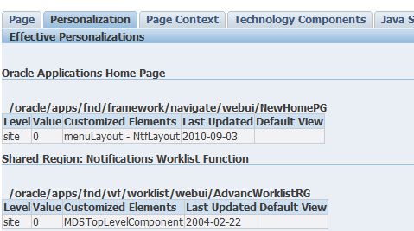

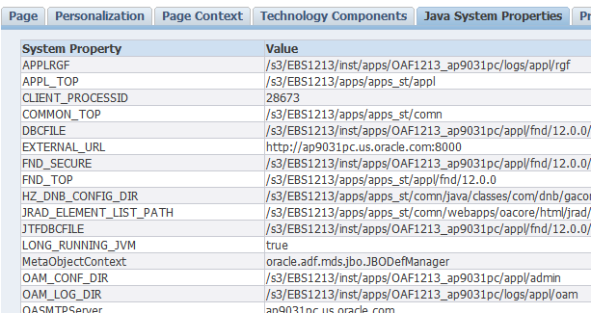
Troubleshooting OAF based applications “About this page” link
Requires “FND: Diagnostics” set to “Yes”

Slide 20
Troubleshooting OAF based applications Personalizations
Files under $PROD_TOP/mds
Uploaded to database via MDS
Disable personalizations for diagnostics purposes
Functional Administrator Responsibility / Application Catalog Tool → Individual personalizations
Disable Self-service Personal / FND_DISABLE_OA_CUSTOMIZATIONS → ALL

Slide 21
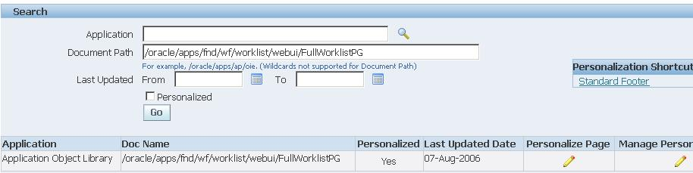
Troubleshooting OAF based applications Personalizations

Slide 22
Troubleshooting OAF based applications Personalizations
Use SQL*Plus to see personalization registration
Turn on diagnostic messaging in SQL*Plus
SQL> set serveroutput on
Review what personalization documents exist for a given page
execute jdr_utils.listcustomizations ('/oracle/apps/fnd/wf/worklist/webui/FullWorklistPG');

Slide 23

Troubleshooting Java Object Cache

Slide 24
Oracle Java Object Cache (JOC) Troubleshooting
Cache invalidation (or lack thereof) issues
Distributed vs. Standalone → Always use Distributed
Always make sure latest patches are applied (JOC AND JTF)
Communication ports: Ensure there are enough available and open in the firewall, except for DMZs
Number of nodes and communication: Use CacheWatchUtil
Cached entities: Use CacheWatchUtil
Most issues might not look cache problems (i.e.: Login page fails to render due to lack of database connectivity)
Clear the cache
Use java’s jconsole to verify hit/miss ratio and additional statistics

Slide 25
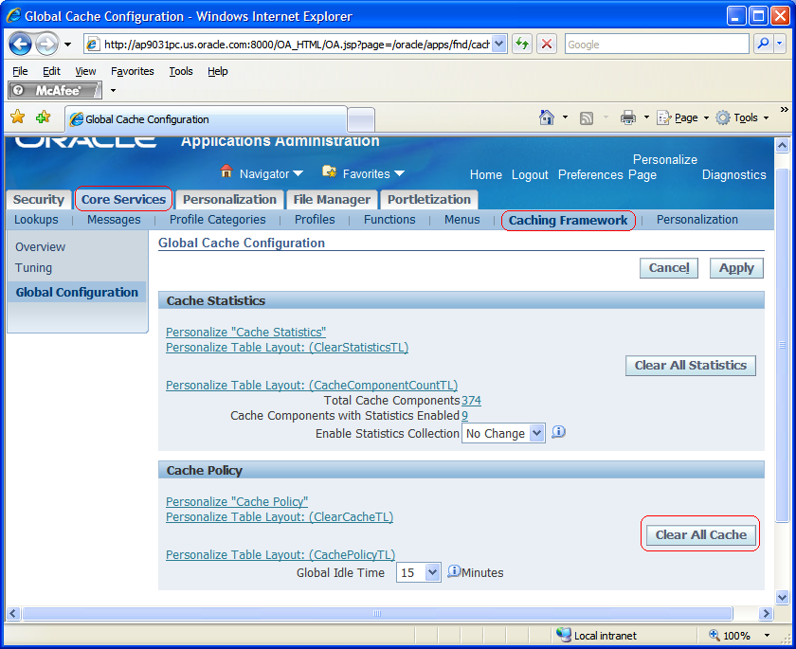
Oracle Java Object Cache (JOC) Clearing the cache
Navigation path:
Functional administrator
→ Core Services
→ Caching Framework
→ Clear all cache

Slide 26
Oracle Java Object Cache (JOC) References
For more information…
MOS notes:
454178.1
455194.1
386568.1

Slide 27
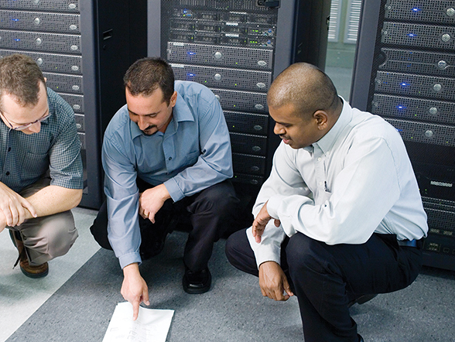
Troubleshooting Oracle forms-based applications

Slide 28

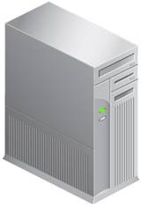

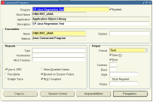
Oracle Forms
Architecture
Desktop client Forms Applet JRE started from browser User Interface 1:1 relation with Forms runtime process | Application Server Listener Forms Servlet (http(s)) OC4J / JSERV Forms Server (socket) frmsrv / f60srvm Runtime process (1 per session) frmweb / f60webmx | Database SQL*NET Interacts with Forms runtime process
Notes:
Schematic overview of the topology
Explain:
Forms applet is the GUI of the Forms session only. Apart from some handling navigation in the applet no Forms logic here
Frmweb / f60webmx process is the actual runtime. All Forms processing (handling of events like triggers, PLSQL code, SQL in database) is done here.
There is 1:1 relation between Forms applet on desktop and runtime process on Application server. If Forms runtime crashes this causes an error in forms applet.
Also termination of Forms applet eventually leads to killing of the Forms runtime process
Forms runtime process is child of Forms Servlet or Form Server

Slide 29
Oracle Forms
Forms Applet
Runs in JRE (previous Jinitiator) on the desktop client
Recommend using latest version of JRE
Note: 290807.1 Deploying Sun JRE (Native Plug-in) for Windows Clients in Oracle E-Business Suite 11i
Note: 393931.1 Deploying Sun JRE (Native Plug-in) for Windows Clients in Oracle E-Business Suite Release 12
Java code for applet downloaded in Forms JAR files
E-Business Suite specific JAR files (fnd<xxxx>.jar)
Generated using ADADMIN utility
JAR files are cached at desktop (per environment)
During Forms startup verification if JAR file on server got changed >> If so a download is performed
Notes:
The problem can be even solved in-house
The best interaction is minimal interaction: open a service request with all necessary info and get the fix in the less number of interactions with support
Network topology, Specific configuration, Usage patterns, Lack of user education can also be causes.

Slide 30
Oracle Forms
Forms patching
Use latest Forms versions + patches:
Note: 125767.1 Upgrading Developer 6i with Oracle Applications 11i
Note: 437878.1 Upgrading OracleAS 10g Forms and Reports in Oracle E-Business Suite Release 12
Forms patch <> Applications patch
Manual copy (Forms 6i) >> no version control, so be careful !!
Opatch (Forms 10G) checks for patch conflicts
Relink Forms executables
Forms classes are ‘replaced’ in 3 steps
Patch is applied to $ORACLE_HOME
ADADMIN builds new FND JAR files based on fndjar.dep
New FND JAR files are downloaded to the desktop client when Forms session starts
Notes:
Ensure to be on latest Forms version for the EBIZ version used
These note are also updated with NEW patches released and recommended to be applied
Do not blindly apply other Forms patches than mentioned in the Note. These are not tested and may report a patch conflict in Forms 10G. Contact Support to review and request merge of Patches
Special attention requested for Forms JAR file patching. The Forms patch is extracted to $ORACLE_HOME, but this as such is not enough. These classes must be uptaken in the FND JAR files, so these can be transferred to the desktop client.
Often the 2nd step is not performed, which makes that patch is believed to be applied, but actually is not “active”
Verify by checking timestamp of the JAR files in $OA_JAVA/oracle/apps/fnd/jar.
In Forms 6i classes are copied manually and there is no version control. So this is very error prone and needs great care to prevent incorrect classes are being picked up
Classes do not have versioning, like apps classes, so comparison is to be done on filesize basis.

Slide 31
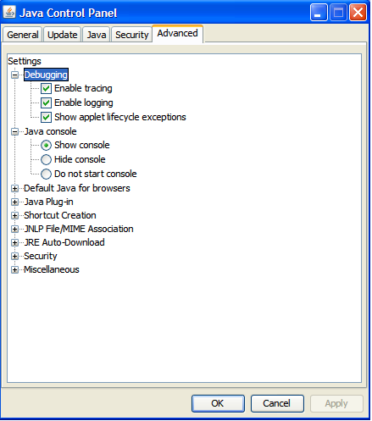
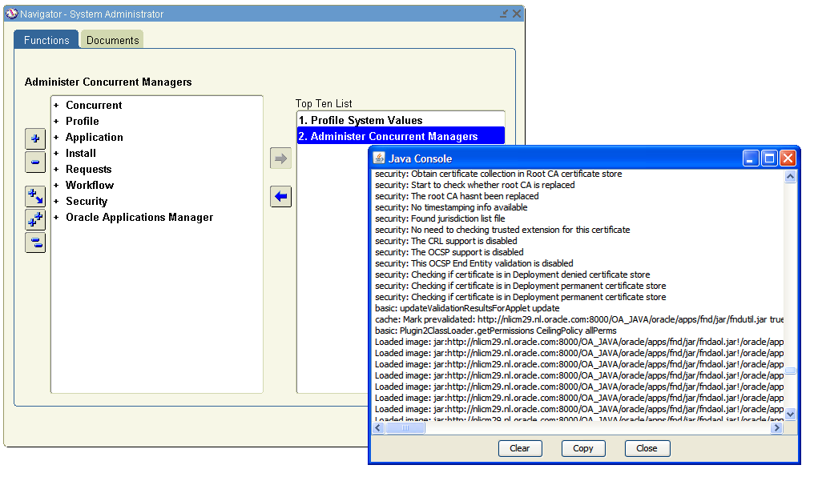
Oracle Forms
Troubleshooting at desktop – Java Console
Java Console: Enable Start > Control Panel > Java
Shows all kind of information and exceptions on
JAR file download, Java stack trace, versions, protocols used
Notes:
Main debugging tool to see what happens in the Applet is the Java Console. Normally switched of, but can simply be enabled.
Requires restart of browser to be picked up
Main problems spotted with this are problems during startup, for example as a result of JAR file download problems.
Also shows Java Stack traces in case of failure in Forms. These are good starting point for further analysis on what went wrong

Slide 32
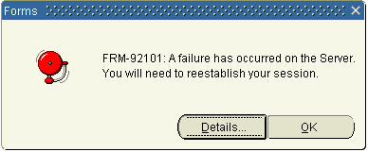
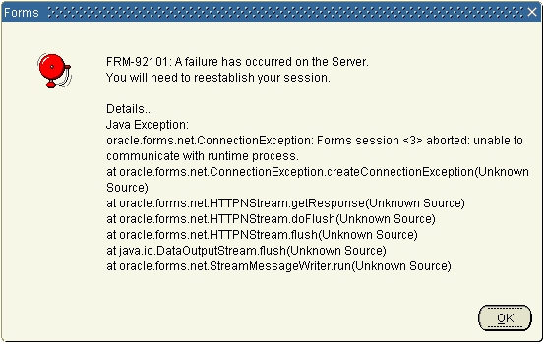
Oracle Forms
Troubleshooting at Desktop – Runtime errors
Severe errors are shown in Error dialog
FRM- message is generic, so always check Details
Most common causes:
Configuration
Server processes not running
Runtime process crash
Network
Note: 444690.1
Notes:
Main debugging tool to see what happens in the Applet is the Java Console. Normally switched of, but can simply be enabled.
Requires restart of browser to be picked up
Main problems spotted with this are problems during startup, for example as a result of JAR file download problems.
Also shows Java Stack traces in case of failure in Forms. These are good starting point for further analysis on what went wrong

Slide 33
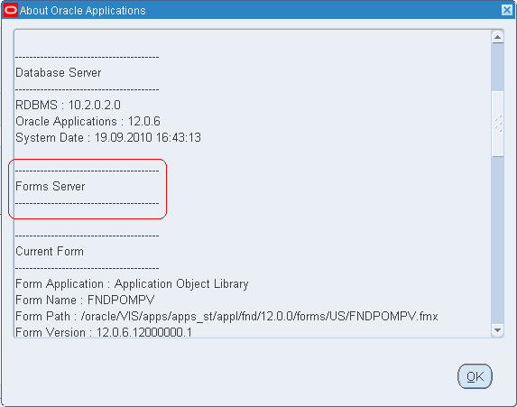
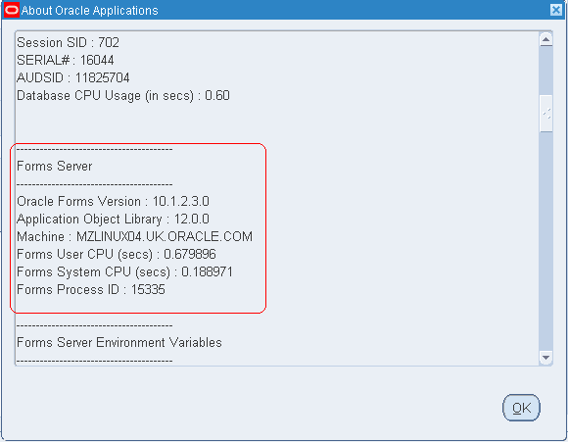
Oracle Forms
Troubleshooting in Forms session
Help > About Oracle Applications… collect information about Forms session + runtime process on server
Set profile FND: Diagnostics = Yes to see all info
Use Help > Diagnostics to
Start a trace for database session
Examine values of item, variables, environment variables, etc
Database errors
Notes:
In About Oracle Applications there is a lot of info about the Forms session, like versions being used, database session, PID + server, environment settings.
Enable DIAGNOSTICS to see all. For security reasons sensitive information is not exposed otherwise, but will be required for proper troubleshooting
With Diagnostics also useful capacities are available to collect information. Like database trace enabling, verification of values of many types, like items, global variables, environment variables.

Slide 34
Oracle Forms
Troubleshooting at Application tier
Creating a FRD trace
Add ?record=collect parameter to ICX: Forms Launcher
Creates file logging Forms opened, navigations, built-in, errors
Resource intensive, so use for ‘dedicated’ Forms session
Note:438652.1 (R12) / Note:150168.1 (R11i)
Identify the <PID> of Forms runtime process
Ensure profile FND: Diagnostics = Yes
Found in Help > About Oracle Applications
With the <PID> it’s possible to
Create truss/tusc/strace output for the Forms runtime process
Verify Forms runtime process remains running or crashes
Check dump file created in $FORM(60)_TRACE_PATH
Notes:
Main debugging tool to see what happens in the Applet is the Java Console. Normally switched of, but can simply be enabled.
Requires restart of browser to be picked up
Main problems spotted with this are problems during startup, for example as a result of JAR file download problems.
Also shows Java Stack traces in case of failure in Forms. These are good starting point for further analysis on what went wrong

Slide 35
Oracle Forms
Troubleshooting Network
Forms uses ‘fixed’ connection between Forms applet and runtime process using the SOCKET or HTTP(S) protocol
Network ‘glitches’ easily cause problems
Forms Server (SOCKET) disconnects session
Forms Servlet (HTTP(S)) use the networkRetries=<x> in appsweb.cfg to attempt re-establish connection <x> times
FORMS(60)_BLOCK_URL_CHARACTERS in apps.conf
Prevents Forms startup in case of ‘inappropriate’ character used
The heartBeat in appsweb.cfg < FORMS(60)_TIMEOUT
Work together to kill or keep alive runtime process
Incorrect settings may cause an unwanted termination
Notes:
Unlike Self Service which is state-less HTML Forms does have a more tense connection between Applet and Runtime process. This is fundamental difference you should be aware of.
In SOCKET communication is done between 2 TCP sockets. When this connection is dropped due to network issue Forms session runs into an error
In SERVLET the networkRetries can be used to attempt re-establashing the communication between Applet and Forms OC4J/runtime process. This is more resilient and pre for SERVLET implementation
FORMS_BLOCK_URL_CHARACTERS may cause strange behaviour for mostly custom Forms. The characters mentioned are blocked for security reasons, so when URL includes them Forms startup is prevented.
The heartBeat and FORM_TIMEOUT are a combination. During idle time runstime sends heartbeat message to verify Forms applet is still available. In case of ‘response’ Forms runtime process keeps alive. When for period longer than FORMS_TIMEOUT no response is received it’s assume Applet is not there anymore, so it’s save to kill the runtime process to clear the resources.
In case of incorrect settings (e.g heartbeat > FORMS_TIMEOUT) the timeout kicks in before heartbeat is send to indicate Applet is still there. Now runtime has gone and when user performs an action an error is raised.

Slide 36
Oracle Forms
Troubleshooting Miscellaneous
Beware of the custom.pll
Ensure no ‘outdated’ versions are around on the filesystem
Location of the FMX / PLX files
Working directory is first checked >> Ensure no files are there
Picked up based on FORMS(60)_PATH
FMX / PLX compilation
Performed using ADADMIN utility
Error: Compile from command line to identify root-cause
(Database) PACKAGE SPEC altered
For performance references to packages fixed at compile time
Change in PACKAGE SPEC require recompilation
Notes:
CUSTOM.pll is customized. Sometimes old versions linger around (e.g. in working directory) and cause error. The custom.pll at expected location seems fine, but in reality it got picked from unexpected location
This may apply also for other PLX/FMX. Working directory is directory from where Forms Server/Servlet is started
Normally of FMX/PLX are compiled with ADADMIN. However in case of problems compilation may fail. In this case it may be useful to try compile command from command line. This normally reveals why compilation fails, for example problem with package being called. Resolve the underlying problem and test compilation again
It’s save to make change to PACKAGE BODY, but when PACKAGE SPEC changes references from PLX become invalid and will raise an error at runtime ORA-4068. In this case PLX/FMX must be recompiled, but since Forms library depends on other Forms library this may cascade

Slide 37

Diagnosing Middle tier performance problems

Slide 38
Defining performance and scalability What do they mean?
Performance
Measured via response time
Scalability
Steady response time despite utilization of the system
Performance and Scalability are very important as they translate into lower cost per transaction

Slide 39
Diagnosing performance problems Common performance issues in the middle tier
Response Time / CPU Usage
Non acceptable response time for a transaction
Deadlocks
Threads locking each other causing applications to “freeze”
Inadequate configuration
Incorrect sizing/configuration for the intended use
Memory Leaks
Allocated memory not released after use

Slide 40

<Insert Picture Here>
Response Time/CPU Issues/Deadlocks

Slide 41
Response Time/CPU Issues
Configure Apache to log the time it takes to service a request by editing httpd.conf and adding the %T option
For 11.5, edit $IAS_ORACLE_HOME/Apache/Apache/conf/httpd.conf
For R12, edit $ORA_CONFIG_HOME/10.1.3/Apache/Apache/conf/httpd.conf
The access log will contain the response time information
For 11.5: $IAS_ORACLE_HOME/Apache/Apache/logs/access_log*
For R12: $LOG_HOME/ora/10.1.3/Apache/access_log*
LogFormat "%{ClientIP}i %l %u %t [ecid: %{Oracle-ECID}i] \"%r\" %>s %b [%T (secs)]" common
** T% allows for response time and ECID allows you to trace the OC4J request and see if it is a failure or success. MOS Note.266662.1

Slide 42
Response Time/CPU Issues
Access log output example:
148.87.19.51 1 - - [01/May/2007:11:38:49 -0700] "GET /OA_HTML/AppsLocalLogin.jsp HTTP/1.1" 200 5986
148.87.19.51 0 - - [01/May/2007:11:38:53 -0700] "POST /OA_HTML/fndvald.jsp HTTP/1.1" 302 259
148.87.19.51 5 - - [01/May/2007:11:38:58 -0700] "GET /OA_HTML/OA.jsp?OAFunc=OAHOMEPAGE HTTP/1.1" 200 41609
148.87.19.51 5 - - [01/May/2007:11:39:15 -0700] "GET /OA_HTML/OA.jsp?OAFunc=OAHOMEPAGE&akRegionApplicationId=0&navRespId=20420&navRespAppId=1&navSecGrpId=0&transactionid=36910577&oapc=2 HTTP/1.1" 200 94506
The second field is the response time in second (%T was added as the second field in the previous examples)
Note: the entry is written when the request is complete, so if it is hanging, you will not find an entry

Slide 43
Response Time/CPU Issues
Rule out SQL issues. See Note 357597.1 on enabling SQL trace for OA Framework applications
Move onto JVM issues
Collect thread dumps
Analyze GC logs
Use Profilers
Record, Analyze and View Heap Dumps

Slide 44
<Insert Picture Here>
Thread Dumps / Deadlocks

Slide 45
Thread Dumps
A Thread Dump shows the stack of each thread in the JVM
Identify expensive methods via series of Thread Dumps
Shows blocked/deadlocked threads
UNIX, issue kill –QUIT <jvm pid>
For JDK 1.5 or above, you can also try jstack <pid>.
For PIDs:
$INST_TOP/admin/scripts/adopmnctl.sh status

Slide 46
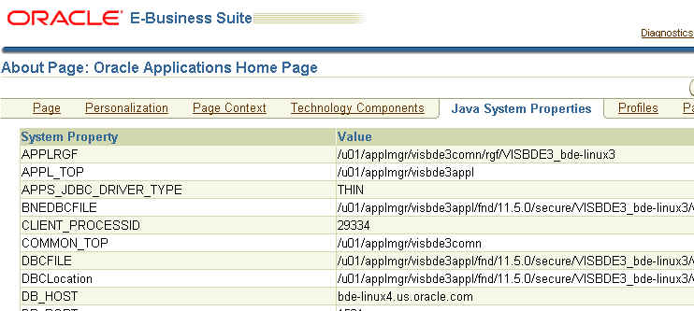
Thread Dumps
System Property CLIENT_PROCESSID in “About this page”
The thread dump will be written to the stdout file
11i:
$IAS_ORACLE_HOME/Apache/Jserv/logs/jvm/OACoreGroup.*.stdout
R12:
$LOG_HOME/ora/10.1.3/opmn/OC4J~oacore~default_group_*
Users ends on same JVM after initial log in

Slide 47
Thread Dumps
Full thread dump:
"Thread-32361" daemon prio=1 tid=0x90787f40 nid=0x542e runnable [0x91e4f000..0x91e5086c]
at java.net.SocketInputStream.socketRead(Native Method)
at java.net.SocketInputStream.read(SocketInputStream.java:85)
. . .
"Thread-27325" daemon prio=1 tid=0x87cfa08 nid=0x4313 waiting on monitor [0x90dff000..0x90dff86c]
at java.lang.Thread.sleep(Native Method)
at oracle.apps.jtf.base.session.Monitor.run(Monitor.java:50)
. . .
"Thread-12" daemon prio=1 tid=0x8099058 nid=0x595c waiting on monitor [0x8f1ff000..0x8f1ff86c]
at java.lang.Object.wait(Native Method)
at oracle.apps.fnd.common.Pool.run(Pool.java:1873)
at java.lang.Thread.run(Thread.java:479)
. . .

Slide 48
Thread Dumps
Thread dump showing a live lock wait:
"Thread-167473" daemon prio=10 tid=000b8f70 nid=171653 lwp_id=7886850 runnable [0x37eff000..0x37efe4f0] at java.net.SocketInputStream.socketRead0(Native Method) at java.net.SocketInputStream.read(SocketInputStream.java:134)
. . .
at oracle.jdbc.driver.OraclePreparedStatement.executeUpdate(OraclePreparedStatement.java:656) - locked <46f6ca40> (a oracle.jdbc.driver.OracleCallableStatement) - locked <46d64270> (a oracle.jdbc.driver.OracleConnection)
. . .
"Thread-1" daemon prio=10 tid=000b6000 nid=14 lwp_id=2015294 waiting for monitor entry [0x39a77000..0x39a764f0] at oracle.jdbc.driver.OracleConnection.isClosed(OracleConnection.java:1554) - waiting to lock <46d64270> (a oracle.jdbc.driver.OracleConnection) at oracle.apps.fnd.common.AppsContext.getJDBCConnection(AppsContext.java:2260)
. . .
This is the thread holding the lock with address 46d64270
This is the thread waiting for the same lock

Slide 49
Deadlocks What are they? What do they do?
Deadlocks can cause the application/process to hang
System instability can result from cleanup thread or monitor thread deadlocks
Deadlocks can be seen in the thread dumps

Slide 50
Deadlocks
Deadlock example in a Sun JVM Thread Dump
Found one Java-level deadlock:
==============================
"Thread-3687": waiting to lock monitor 0x08097d74 (object 0x50973e58, a oracle.apps.fnd.framework.server.OADBTransactionImpl),
which is held by "Thread-3579"
"Thread-3579": waiting to lock monitor 0x08097dac (object 0x50972a40, a oracle.jbo.JboSyncLock),
which is held by "Thread-3687"

Slide 51
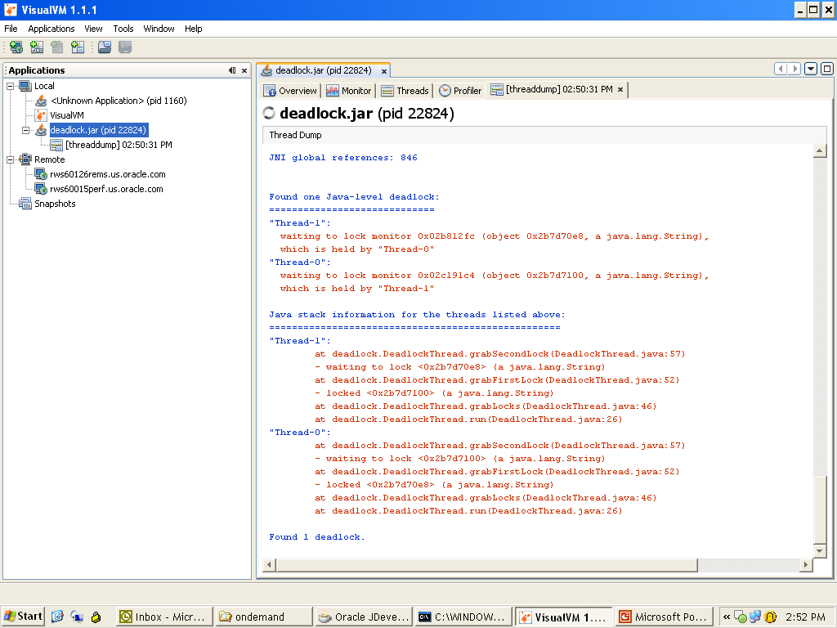
Deadlocks w/ Visual VM

Slide 52
<Insert Picture Here>
OutOfMemoryError / Memory Leaks

Slide 53
JVM Heap Management
A typical Java program creates objects
Objects are allocated from the Java heap, and are garbage collected when there are no more strong references to them
Java heap is divided into multiple generations (memory pools). Each pool holds objects of a certain age
Eden – newly created objects
Survivor – short to medium-lived objects
Tenured (Old) – long-lived objects
Permanent – class files

Slide 54
Garbage Collection
New objects are allocated from Eden
Eden full → minor collection (Partial GC).
Objects still strongly referenced moved to the survivor space
Objects in survivor space “old” enough, moved to old generation.
Old generation full → major collection (Full GC).

Slide 55
Monitor JVM Garbage Collection
–verbose:gc option → monitors JVM GC and heap usage
Autoconfig adds this option
Review log files
steadily increasing heap → possible memory leak.
11i:
$IAS_ORACLE_HOME/Apache/Jserv/logs/jvm/OACoreGroup.*.stdout
R12:
$LOG_HOME/ora/10.1.3/opmn/OC4J~oacore~default_group_*
JDK 1.5.0_08 → Timestamp relative to JVM startup
Prior versions → Relative to first GC event

Slide 56
Monitor JVM Garbage Collection
Sample output for Sun’s JVM:
0.000: [GC 143357K->34512K(514048K), 1.5519252 secs]
103.925: [GC 177872K->44238K(514048K), 0.7564096 secs]
124.894: [GC 187598K->51968K(514048K), 0.5778231 secs]
687.205: [Full GC 366626K->230896K(514048K), 7.3117923 secs]
GC begin time
Minor GC is usually fast
Time taken for GC
Heap Usage before GC
Current Heap Capacity
Full GC is much slower
Heap Usage after GC

Slide 57
Monitor JVM Garbage Collection
Use –XX:+PrintGCDetails for more information about generations at GC:
6.037: [Full GC [PSYoungGen: 1718K->0K(12480K)] [PSOldGen: 3488K->5178K(113856K)] 5207K->5178K(126336K) [PSPermGen: 10241K->10241K(20736K)], 0.0691040 secs]
9.187: [GC [PSYoungGen: 423K->80K(12480K)] 5602K->5258K(126336K), 0.0011820 secs]
9.188: [Full GC [PSYoungGen: 80K->0K(12480K)] [PSOldGen: 5178K->5179K(113856K)] 5258K->5179K(126336K) [PSPermGen: 10242K->10242K(23296K)], 0.0629940 secs]
jstat (JDK 1.5 onwards) to monitor GC

Slide 58
OutOfMemoryError
OutOfMemoryError → JVM unable to free up memory after GC
Request to create a new object could fail with an OOME
A request to load a class could fail with OOME
Not enough space in the permanent generation
Probably cause: many modules in use with limited number of JVMs

Slide 59
OutOfMemoryError
OOME occurs → Error message depends on JDK version
JDK 1.4.2 → no details:
java.lang.OutOfMemoryError
JDK 1.5 → tells you which heap area but no give stack trace
java.lang.OutOfMemoryError: Java heap space
java.lang.OutOfMemoryError: PermGen space
JDK 1.6 → heap area + stack trace
Exception in thread "main" java.lang.OutOfMemoryError: Java heap space
at Test.main(Test.java:10)

Slide 60
OutOfMemoryError
The error message could appear in a variety of places
On the browser window
In FND_LOG_MESSAGES
11i
In $IAS_ORACLE_HOME/Apache/Jserv/logs/jvm/OACoreGroup.*.stderr
R12
In $LOG_HOME/ora/10.1.3/opmn/oacore_default_group_*/oacorestd.err

Slide 61
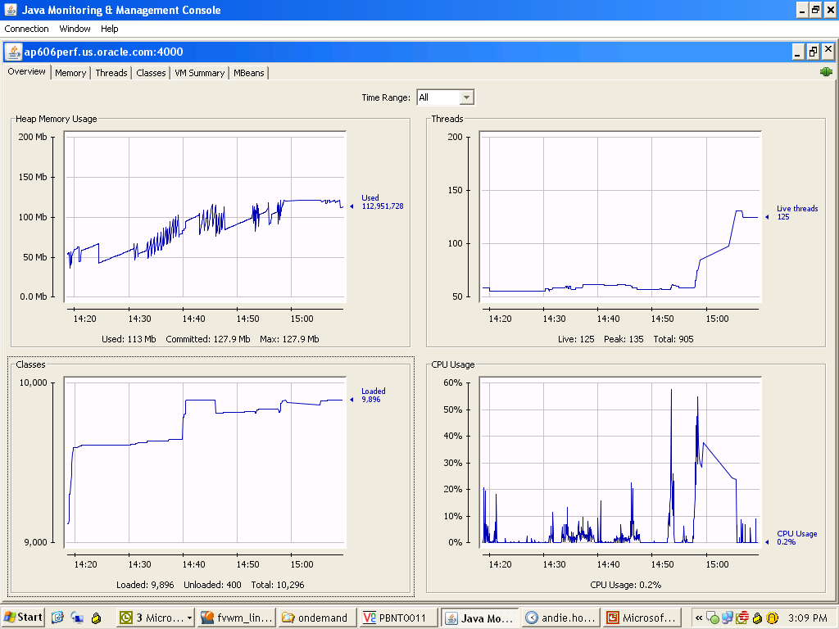
Jconsole Diagnosis of OOME

Slide 62
Collecting OutOfMemoryError Information
Error Logs
Tell you which kind of OOME
Shows you the place where OOME occurs (JDK 1.6)
GC Logs
Allows you to see memory growth trend over time
The trend can be used to determine general cause of OOM
Useful to provide to support when logging service request

Slide 63
OutOfMemoryError log file contents…
This will be present in the $LOG_HOME/ora/10.1.3/opmn/default_group~oacore~default_group~1.log
10063.579: [Full GC 118783K->118783K(124928K), 1.2299950 secs]
10064.810: [Full GC 118783K->117911K(124928K), 1.3957510 secs]
10066.269: [Full GC 118783K->118783K(124928K), 1.2217780 secs]
10067.492: [Full GC 118783K->118783K(124928K), 1.2127460 secs]
10068.706: [Full GC 118783K->118783K(124928K), 1.2166770 secs]
10069.924: [Full GC 118783K->117977K(124928K), 1.2416330 secs]
java.lang.OutOfMemoryError: GC overhead limit exceeded
Dumping heap to java_pid8515.hprof ...
Heap dump file created [149076109 bytes in 10.240 secs]
Heap Location is here:
-bash-3.2$ cd $INST_TOP/../../../apps/tech_st/10.1.3/j2ee/home
-bash-3.2$ ls -l *hprof
-rw------- 1 oraperf dba 149076109 Jan 26 11:11 java_pid8515.hprof
-bash-3.2$

Slide 64
Collecting OutOfMemoryError Information
Class Histogram over a period of time
Add -XX:+PrintClassHistogram switch and send kill –QUIT signals to JVM
Shows memory utilization by instances of each class
Helps in conjunction with heap dumps by trending memory usage of each class
Heap Dump
Provides the most information
Allows you to see what objects are in the heap and the reference graph.
Reference graph tells you why the object remains in the heap
Due to their large size, ask the customer to compress the heap. This will speed up analysis and problem resolution
Also do notice that once you take the heap dump that the objects cleaned may need to be recreated.

Slide 65
Getting Heap Dumps – Sun JVM
Sun JDK 1.4.2_12 and JDK 1.5 have new options to dump the JVM heap
Add –XX:+HeapDumpOnOutOfMemoryError –XX:HeapDumpPath=/tmp to the JVM options in opmn.xml enabled oacore section.
If there is an OutOfMemoryError, the contents of the heap will be dumped to a file in the directory specified by –XX:HeapDumpPath
The heap dump file can be read by the Heap Analysis Tool (HAT), or jhat (in JDK 6), or one that supports the binary heap dump format (e.g. Eclipse Memory Analyzer Tool)
New enhancement on JDK 1.4.2 and 1.5 to dump heap on signal: http://forum.java.sun.com/thread.jspa?threadID=5179031

Slide 66
OutOfMemoryError causes
Common causes of OOME
Memory Leak – Some objects not cleaned up after an operation, or incorrect cache management
Memory Hemorrhage - Infinite loops or consuming vast amounts of memory by reading large data sets
Blocking – Deadlock/Blocking of cleanup threads preventing normal cleanup operations
Sizing Issues – Heap is undersized for expected load

Slide 67
EBS Sizing Recommendations
Metalink note#: 362851.1
JVM NewRatio = 2
Xmx=Xms
Xmx=Xms=1024mb to start with.
Load testing → Key.
This would ensure that the projected # of users are able to have a pleasant time using the system\
Autoconfig takes care of the recommended values

Slide 68
Identifying Memory Leaks
Symptoms:
Heap usage increases steadily over a relative longer period of time (e.g. several hours or days)
When memory leak is large enough → continuous Full GC
Different users may encounter OOM on totally unrelated flows

Slide 69
Identifying Memory Leaks
Find the source of the memory leak (Important)
Get a heap dump when the OOME occurs
Get series of class histograms over time and observe what classes are growing
-XX:+PrintClassHistogram. The + enables the option, the – disables it. Add to the opmn.xml enabled oacore section.
If possible, get a series of heap dumps and observe what classes are growing
Get a series of thread dumps and see if there are any cleanup threads that are deadlocked/blocked

Slide 70
Connection and JDBC Statement Leaks
Prior to 11.5.10, memory leaks are also frequently caused by JDBC statement/connection leaks.
In 11.5.10 and R12, these have been decreased by having GSCC checks and more monitoring during system test
Prior to R12, you can use AoljDbcPoolStatus.jsp or OAM to monitor connection leak
In R12, you also need to monitor the stdout/stderr logs for connection leaks

Slide 71
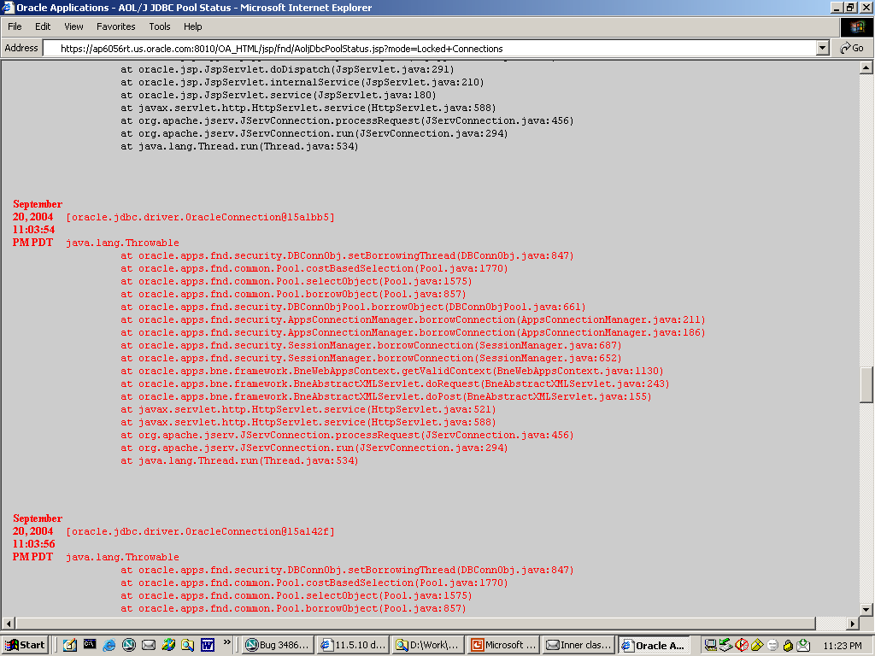
Connection and JDBC Statement Leaks
Use <host>:<port>/OA_HTML/jsp/fnd/AoljDbcPoolStatus.jsp
Need to login as user with FND:Diagnostics profile set to Yes.

Slide 72
Identifying Memory Hemorrhage
Symptoms of memory hemorrhage
Free heap after GC decreases rapidly, over a short period of time (e.g. serveral seconds or minutes)
Continuous Full GC in the GC log
The OOME is reproducible. A particular flow will always trigger the OOME

Slide 73
Identifying Memory Hemorrhage
Finding the source
Flow causing the OOME
StackOverflowError → infinite loops: Take thread dumps regularly and look for very deep stacks.
Get heap dump at OOME occurrence

Slide 74
<Insert Picture Here>
Java Diagnostic Tools / Methods

Slide 75
Tools for Diagnosing Heap Dumps
Regardless the tool, always…
Look for classes/dominators occupying most of the heap
Look for reference path to the root to determine why the instances remain in memory
Discuss with appropriate support team.
Performance

Slide 76
Tools for Viewing Heap Dumps
Oracle’s JHat bundled with JDK 1.6.0
Primitive UI
Slow
Visual VM Java Profiler
Similar to Jconsole + profiling. Colorful output and graphs
Eclipse Memory Analyzer
Faster heap analysis, able to process large heap dumps
Use 64bit for heaps larger than 2GB
IBM – IBM Heap Analyzer
http://www.alphaworks.ibm.com/tech/heapanalyzer
Oracle AD4J

Slide 77
Jconsole Diagnostic Tool
Provided by Oracle with JDKs (version 5/6).
Visual reporting of resources in use of a running JVM
JDK6 onwards → ad-hoc, on demand heap dumps
Huge improvement of JDK5 non-cooperative mechanism
Visual instrumentation for memory segments and how are they doing

Slide 78
Jconsole remote diagnostics
Using JMX (Java Management Extensions)
Remote monitoring: Add the following to opmn.xml).
-Dcom.sun.management.jmxremote.authenticate=false
-Dcom.sun.management.jmxremote.ssl=false
-Dcom.sun.management.jmxremote.port=4000
Not managed by autoconfig
For more options please see JMX documentation at OTN

Slide 79
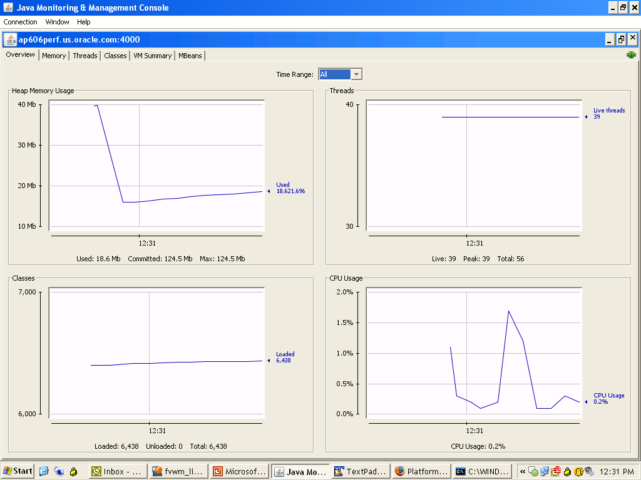
Jconsole Diagnostic Tool Overall

Slide 80
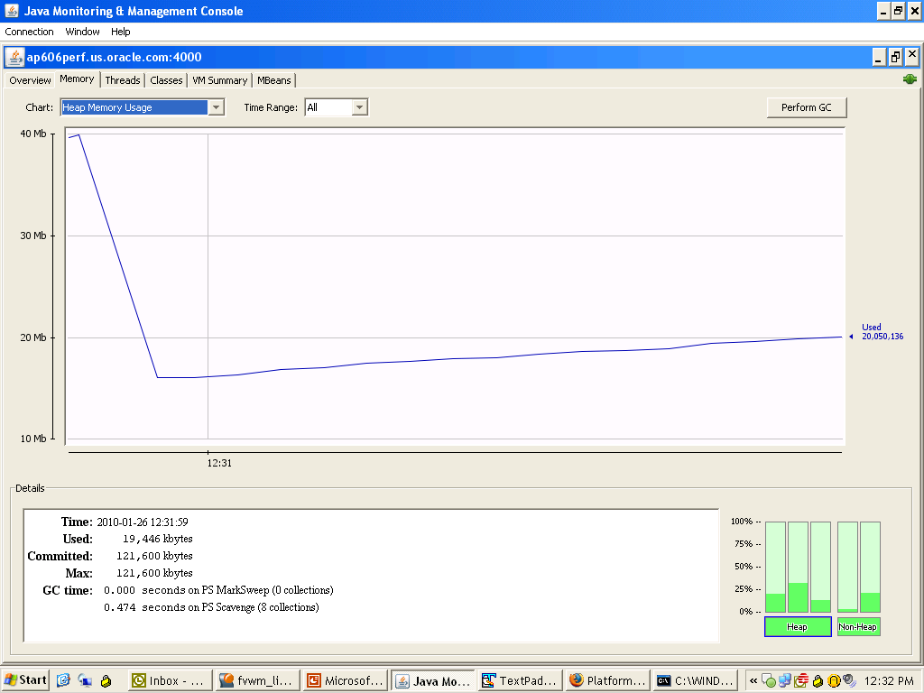
Jconsole Diagnostic Tool Memory tab

Slide 81
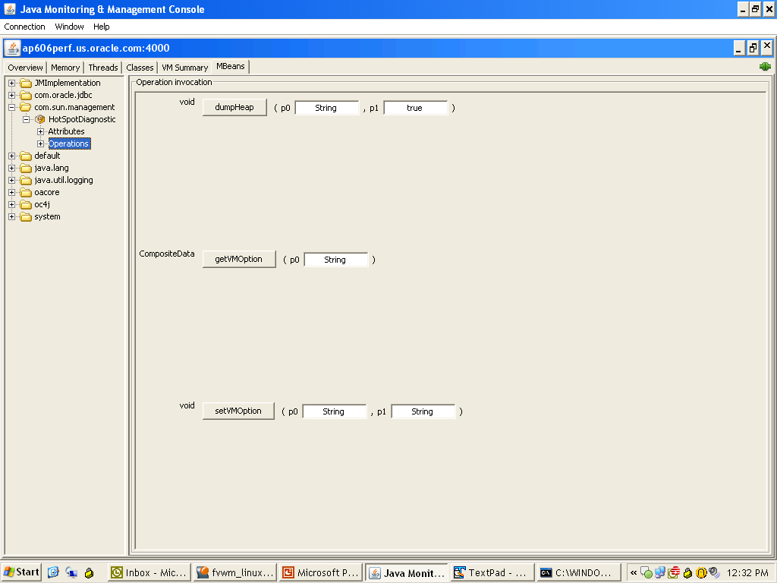
Jconsole Ad-hoc heap dumps

Slide 82
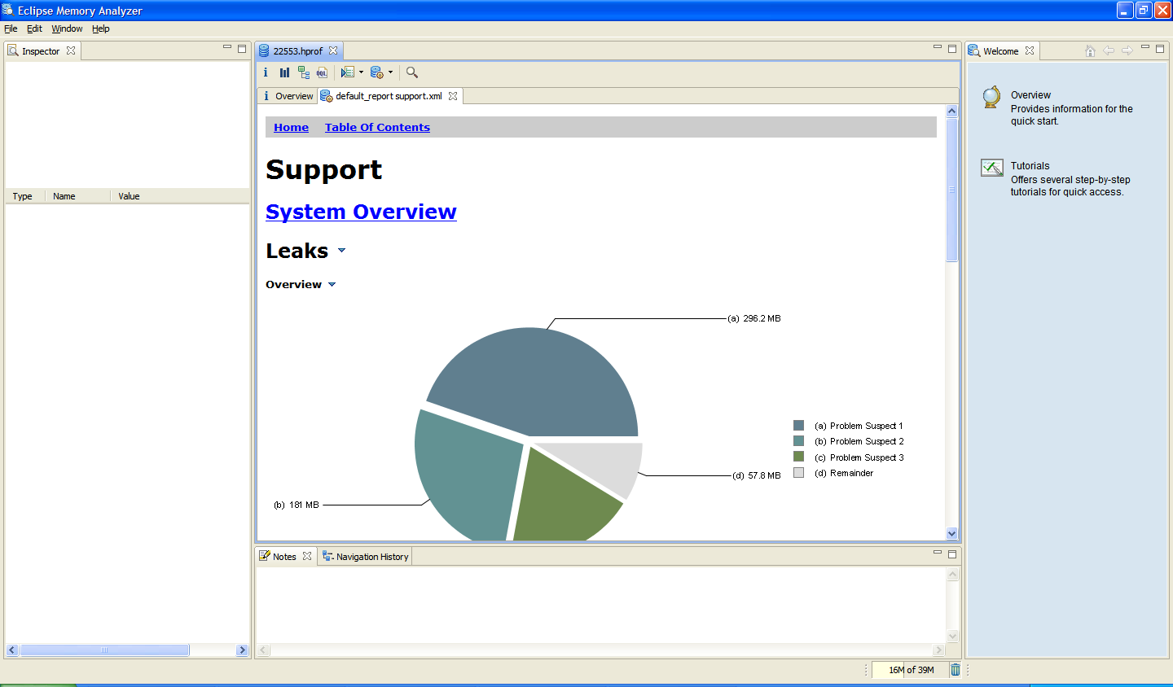
MAT – Eclipse Memory Analyzer Tool For dealing with heap dumps

Slide 83
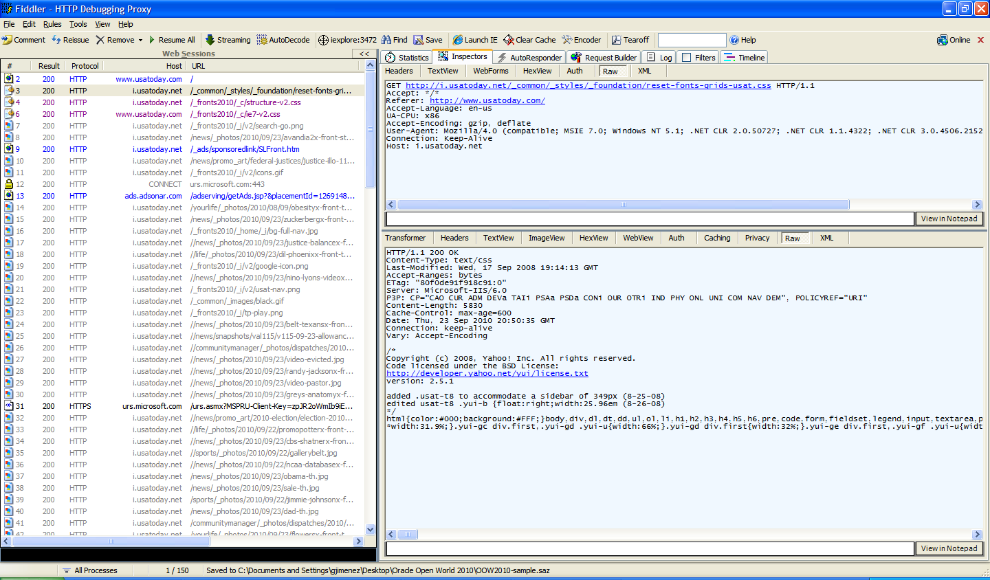
Fiddler2 Analyze HTTP traffic
See http://www.fiddler2.com/ for instructions

Slide 84
When reporting a problem to Support What information is really necessary?
Check all relevant versions to the failing page in the “About this page” link and add it to the service request
Remember to enable “FND: Diagnostics” profile option (at least, for a single user)
Upload all relevant logs:
$INST_TOP/logs/*
Patches recently applied
Any relevant information
Java exceptions: Full exception
Notes:
The problem can be even solved in-house
The best interaction is minimal interaction: open a service request with all necessary info and get the fix in the less number of interactions with support
Network topology, Specific configuration, Usage patterns, Lack of user education can also be causes.

Slide 85

Questions and Answers

Slide 86
Related Sessions – Technology Overview
Monday, September 20
Tuesday, September 21
Ten Things You Can Do Today to Prepare for Oracle Fusion Applications (S316898) 11:00 am-12:00 pm, Moscone West L2 Rm 2001
Quick Wins That Will Make You a Hero: Oracle E-Business Suite Technology (S318132) 12:30 pm-1:30 pm, Moscone West L2 Rm 2024
Oracle E-Business Suite Technology: Vision, Release Overview, Product Roadmap (S317132) 12:30 pm-1:30 pm, Moscone West L2 Rm 2002/2004

Slide 87
Related Sessions – Technology Overview
Wednesday, September 22
Oracle E-Business Suite Technology Certification Primer and Roadmap (S318119) 10:00 am-11:00 am, Moscone West L2 Rm 2024
Oracle E-Business Suite Product Roadmap (S318107) 1:00 pm-2:00 pm, Moscone West L3 Rm 3002/3004
Thursday, September 23
Oracle E-Business Suite Architectures: Oracle RAC, Clouds, Oracle VM, and More (S318120) 12:00 pm-1:00 pm, Moscone West L2 Rm 2024
Oracle E-Business Suite Technology: Vision, Release Overview, Product Roadmap (S318122) 4:45 pm-5:45 pm, Moscone West L3 Rm 3002/3004

Slide 88
Related Sessions – Security
Monday, September 20
Data Privacy and Protection in Oracle E-Business Suite (S317107) 11:00 am-12:00 pm, Moscone West L2 Rm 2024
Thursday, September 23
Service-Oriented Security: Simplifying Identity Management for Applications (S317270) 10:30 am-11:30 am, Moscone West L3 Rm 3018

Slide 89
Related Sessions – Integration
Monday, September 20
Tuesday, September 21
An Oracle E-Business Suite Integration Primer: Technologies and Use Cases (S318126) 3:30 pm-4:30 pm, Moscone West L2 Rm 2024
Enabling Web Services with Oracle E-Business Suite Integrated SOA Gateway (S318127) 5:00 pm-6:00 pm, Moscone West L2 Rm 2024
Hands-On Lab: Oracle E-Business Suite Integrated SOA Gateway: Web-Services-Based Integrations (S318747) 12:30 pm-1:30 pm, Marriott Marquis Nob Hill CD

Slide 90
Related Sessions – Extending and Customizing
Monday, September 20
Tuesday, September 21
Rich User Interface in Oracle Application Framework Modules (S318128) 3:30 pm-4:30 pm, Moscone West L2 Rm 2020
Hands-On Lab: Building Desktop Integrators with Oracle Web Applications Desktop Integrator (S318746) 2:00 pm-3:00 pm, Marriott Marquis Nob Hill CD
Hands-On Lab: Oracle Application Framework Usability (S318745) 5:00 pm-6:00 pm, Marriott Marquis Nob Hill CD

Slide 91
Related Sessions – Extending and Customizing
Wednesday, September 22
Upgrading Your Customizations to Oracle E-Business Suite Release 12 (S318125) 11:30 am-12:30 pm, Moscone West L2 Rm 2024
Using Oracle Web Applications Desktop Integrator for Rapid Desktop Integrations (S318129) 1:00 pm-2:00 pm, Moscone West L2 Rm 2024
Thursday, September 23
Personalize, Customize, and Extend Oracle E-Business Suite User Interface (S318130) 10:30 am-11:30 am, Moscone West L2 Rm 2024
Extending Oracle E-Business Suite with Oracle ADF and Oracle SOA Suite (S318061) 4:45 pm-5:45 pm, Moscone West L2 Rm 2020
Hands-On Lab: Oracle Application Framework Usability (S318745) 3:00 pm-4:00 pm, Marriott Marquis Nob Hill CD
Hands-On Lab: Building Desktop Integrators with Oracle Web Applications Desktop Integrator (S318746) 9:00 am-10:00 am, Marriott Marquis Nob Hill CD

Slide 92
Related Sessions – Performance and Availability
Tuesday, September 21
Tuning All Layers of the Oracle E-Business Suite Environment (S317108) 12:30 pm-1:30 pm, Moscone West L2 Rm 2020
Maximum Availability Architecture Best Practices: Oracle E-Business Suite Release 12.1 (S317131) 3:30 pm-4:30 pm, Moscone West L2 Rm 2020
Deploying Oracle E-Business Suite on the Oracle Exadata: Tips/Best Practices (S317130) 5:00 pm-6:00 pm, Moscone West L2 Rm 2020
Hands-On Lab: Diagnose and Identify Performance Issues with Oracle E-Business Suite (S318989) 3:30 pm-4:30 pm, Marriott Marquis Nob Hill CD

Slide 93
Related Sessions – Performance and Availability
Wednesday, September 22
Hands-On Lab: Diagnose and Identify Performance Issues with Oracle E-Business Suite (S318989) 10:00 am-11:00 am, Marriott Marquis Nob Hill CD
Thursday, September 23
Oracle E-Business Suite Advanced Performance Topics: Oracle RAC, Compression (S317109) 3:00 pm-4:00 pm, Moscone West L2 Rm 2020

Slide 94
Related Sessions – Internationalization
Wednesday, September 22
Oracle E-Business Suite Internationalization / Multilingual Support Best Practices (S318131) 4:45 pm-5:45 pm, Moscone West L2 Rm 2024

Slide 95
Related Sessions – Upgrading
Tuesday, September 21
Oracle E-Business Suite Release 12.1 Upgrade Best Practices: Technical Insight (S317955) 2:00 pm-3:00 pm, Moscone West L2 Rm 2020
Wednesday, September 22
True Story of Upgrading from Oracle E-Business Suite 11i to Release 12.1 (S318313) 11:30 am-12:30 pm, Moscone West L3 Rm 3002/3004
Upgrading Your Customizations to Oracle E-Business Suite Release 12 (S318125) 11:30 am-12:30 pm, Moscone West L2 Rm 2024
Planning Your Oracle E-Business Suite Upgrade from Release 11i to Release 12.1 (S318311) 3:30 pm-4:30 pm, Moscone West L2 Rm 2018

Slide 96
Related Sessions – Lifecycle Management
Monday, September 20
Tuesday, September 21
Hands-On Lab: Oracle Application Management Pack for Oracle E-Business Suite: Monitor/Clone (S318765) 5:00 pm-6:00 pm, Marriott Marquis Nob Hill CD
Latest on Oracle Application Change Management Pack for Oracle E-Business Suite (S318124) 3:30 pm-4:30 pm, Moscone West L2 Rm 2024
Hands-On Lab: Using Oracle Application Change Management Pack for Oracle E-Business Suite (S318766) 11:00 am-12:00 pm, Marriott Marquis Nob Hill CD

Slide 97
Related Sessions – Lifecycle Management
Wednesday, September 22
Hands-On Lab: Using Oracle Application Change Management Pack for Oracle E-Business Suite (S318766) 4:45 pm-5:45 pm, Marriott Marquis Nob Hill CD
Thursday, September 23
Reduce TCO with Oracle Application Management Pack for Oracle E-Business Suite (S318123) 9:00 am-10:00 am, Moscone West L2 Rm 2024
Oracle E-Business Suite Applications Technology: Diagnostics and Troubleshooting (S318121) 3:00 pm-4:00 pm, Moscone West L2 Rm 2024

Slide 98
Related Sessions – DBA Techniques
Tuesday, September 21
Oracle E-Business Suite DBA Techniques: Minimizing Maintenance Downtimes (S318134) 2:00 pm-3:00 pm, Moscone West L2 Rm 2024
Wednesday, September 22
Practices for Virtualizing and Migrating Oracle E-Business Suite to Linux (S316885) 1:00 pm-2:00 pm, Moscone South Rm 305
Thursday, September 23
Oracle E-Business Suite DBA Techniques: Install and Cloning Best Practices (S318133) 1:30 pm-2:30 pm, Moscone West L2 Rm 2024

Slide 99
Related Demos
Demo | Location
Upgrading to Oracle E-Business Suite 12.1 | Moscone South, S-089
Advanced Architectures and Technology Stack Components | Moscone South, S-090
SOA-Based Integration for Oracle E-Business Suite | Moscone South, S-091
End-to-End Management of Oracle E-Business Suite | Moscone South, S-092
Oracle Applications Framework Rich UI and Enhanced Web ADI | Moscone South, S-094

Slide 100
Additional Related Sessions
Applications Tools and Technology Track
Focus On Applications Tools and Technology (Oracle E-Business Suite) http://www.oracle.com/technetwork/apps-tech /ebusiness/focuson-ebs-tools-tech-oow-2010-167565.pdf

Slide 101
Oracle OpenWorld Latin America 2010
December 7–9, 2010

Slide 102
Oracle OpenWorld Beijing 2010
December 13–16, 2010

Slide 103


Oracle Products Available Online
Oracle Store
Buy Oracle license and support online today at oracle.com/store
Notes:
103

Slide 104


Slide 105
声明：
所有的版权属于原有公司，文件均来自公开渠道
此文件仅供学习使用，任何人不得进行以此为商业目的的行为
如有疑问，请立即删除
学习世界五百强和咨询公司PPT课程请访问如下网站搜索：“司马懿”
百度传课：司马懿PPT学校
https://www.chuanke.com
网易学堂：司马懿PPT学校
https://study.163.com
知乎： 司马懿PPT学校
https://www.zhiu.com

